Slide 1
529 Data Analytics
October 19, 2016
DIVVY Bike Rentals and Weather Data
Sarin Ravishanker – A20349372
Anirudh Srikanthan – A20354161

Slide 2
Table of Contents
Business Scenario
Business Objective
Dataset Information
Variables
Data Preprocessing / Activities
Exploratory Data Analysis Results
Regression Modeling Results
Trip Count Vs Gender Results using PROC GLM
Conclusion

Slide 3
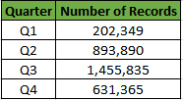
Business Scenario
Divvy is a program of the Chicago Department of Transportation (CDOT), which provides a bike share system with thousands of bikes available at more than 580 stations across the region. Divvy provides residents and visitors with a convenient, fast, fun, and affordable transportation option for getting from Point A to Point B.
Divvy will be available for use 24 hours a day, 365 days a year to the general public and the bikes can be rented from and returned to any station in the system.
The Divvy bike data collected for the period 2015(Q1-Q4) will be analyzed against weather data.
Given Below is the record count which is equivalent to the each trip record for the year 2015:
The weather data collected for 2015 contains 365 rows of data, with several key attributes like Temperature, Humidity ,Dew-Point and Sea-Level Pressure.

Slide 4
Business Objective
As Divvy bikes can be used throughout the year, a comparison along with weather data for the year is performed.
The Trip count and Trip duration are analyzed against key weather factors such as Temperature, Humidity and Dew-Point.
Questions Analyzed
At what time of the year are the highest and lowest trip counts recorded?
How Strongly is Temperature, Humidity and Dew point co-related to Trip Count?
Which weather factor influences the Trip Count and Trip Duration the Most?
What is the influence on Trip Duration according to Gender?

Slide 5
Dataset Information
 | DIVVY Rental Data - Chicago | Weather Data - Chicago
Source | https://www.divvybikes.com/data | https://www.wunderground.com/
File Names | DIVVY_Q1-Q4_2015.csv | Weather_Chicago_2015.csv
Number of Rows | 2,183,439 | 365
Number of Variables | 12 | 20
Time Period | 2015 (Q1-Q4) | 2015(Q1-Q4)

Slide 6

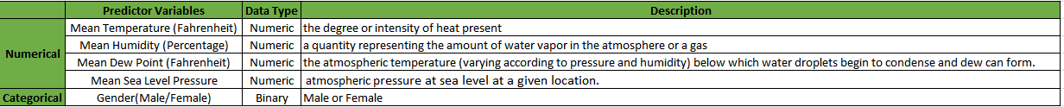
Variables
The key response and predictor variables considered for the analysis are shown below:
Response Variables:
Predictor Variables:

Slide 7
Data Preprocessing/Activities
Divvy Dataset Processing
From the Divvy Dataset, out of the 12 attributes, only 5 attributes have been considered for analysis namely Start Date and Time, End Date and Time, Duration , Trip ID, and Gender.
The total trip count and total trip duration(in hours) for each day was pre-calculated in Excel and mapped with the corresponding weather factors i.e Mean Temperature, Mean Humidity, Mean Sea Dew Point, Mean Sea Level Pressure.
Weather Dataset Processing
Total Number of Rows – 365
Out of 23 attributes, only 4 attributes were considered for the analysis i.e. date, temperature, humidity , Dew Point and Sea Level pressure.
Data Activities
Find correlation coefficient of the predictor variables(Trip Count and Trip Duration) with weather related variables.
Scatter plot between Predictor Variables and weather data.
Perform multiple regression Analysis Modelling with Trip Count using PROC GLM SELECT.
Perform linear modelling using PROC GLM with categorical predictor variables.

Slide 8
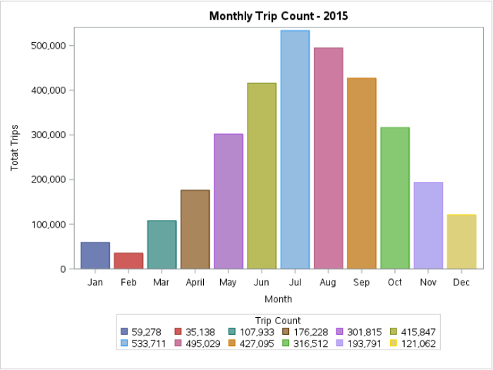
Exploratory Data Analysis Results Monthly Trip Count
Graph.1 – Monthly Trip Count in 2015
At what time of the year are the highest and lowest trip counts recorded?
As shown in Graph.1, its clear that the trip counts are highest during the summer months, with highest trip count recorded in July 2015.
The trip count decreases during colder months, with lowest recorded in February 2015.

Slide 9
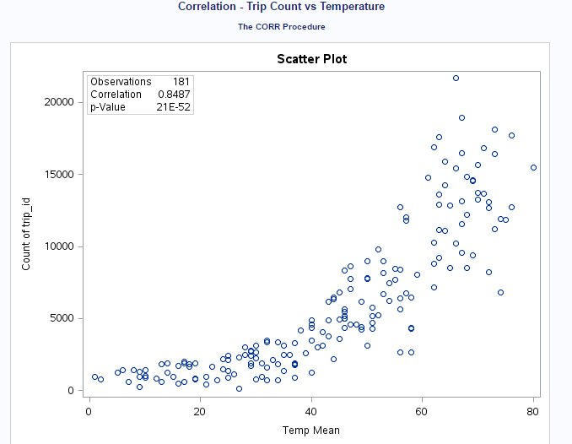
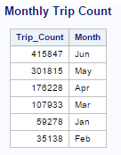
Exploratory Data Analysis Results Correlation Results – 1
How Strongly is Temperature co-related to Trip Count?
On Analyzing Q1-Q2 data, Trip Count a has positive linear relationship with Temperature.
It indicates that there is steady increase in the number of trips transitioning from colder temperature to warmer temperatures.
Graph.2 Trip Count vs Temperature
Its also evident monthly average number of trips are recorded during summer months as shown in the table – Tab.1
Tab.1 Monthly Trip Count

Slide 10
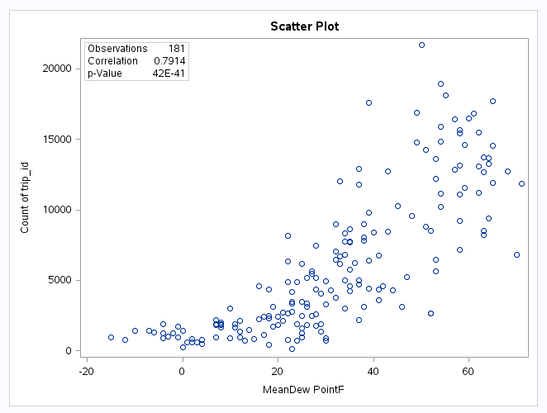
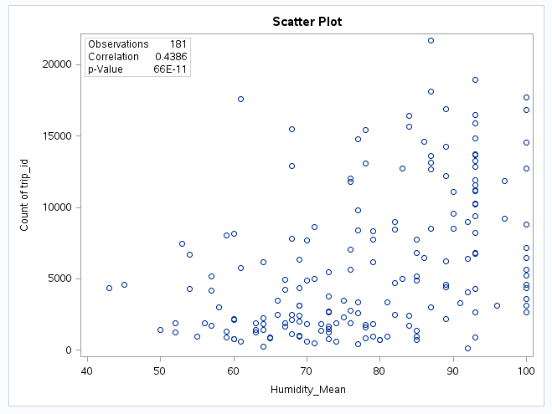
Exploratory Data Analysis Results Correlation Results - 2
Graph.3 Trip Count vs Temperature
Graph.4 Trip Count vs Humidity
How Strongly are Dew-Point and Humidity co-related to Trip Count?
Trip count has positive linear relationship with both Dew Point and Humidity, but lesser than temperature.
Warm air has a tendency to hold more water vapor than cold air.

Slide 11
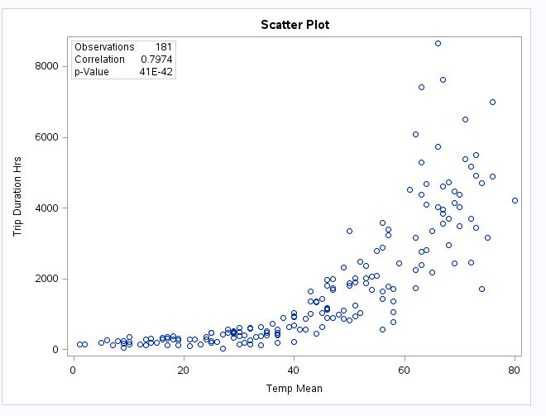
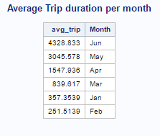
Exploratory Data Analysis Results Correlation Results – 3
How Strongly is Temperature co-related to Trip Duration?
From the Correlation result shown in Graph.5, Trip Duration has a positive linear relationship with Temperature.
It indicates that there is steady increase in the trip duration transitioning from colder temperature to warmer temperatures.
Graph.5 Trip Duration vs Temperature
The average monthly trip duration is shown in Tab.2, where the summer months tend to have longer trip durations.
Tab.2 – Average Trip Duration Per month

Slide 12
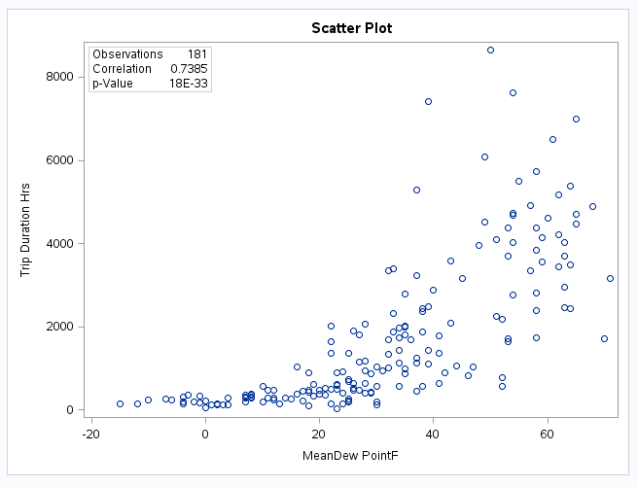
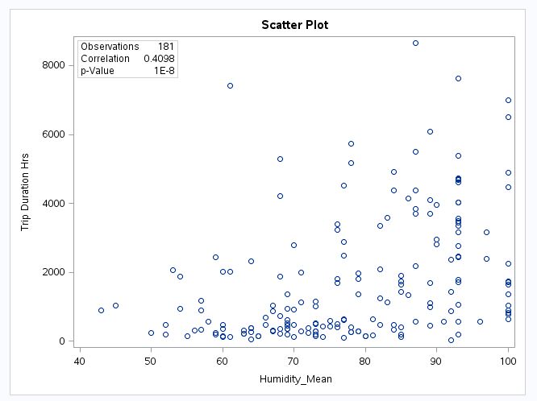
Exploratory Data Analysis Results Correlation Results – 4
Graph.6 - Trip Duration vs Dew-Point
Graph.7 - Trip Duration vs Humidity
Trip Duration has Positive Linear relationship with Dew Point and relatively weak relationship with Humidity as shown in Graph.6 and Graph.7 respectively.

Slide 13
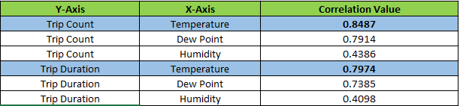
Exploratory Data Analysis Results Correlation Results Inference
Tab.3 – Correlation Summary
From the correlation analysis performed with Trip Count and Duration against Weather Factors we can infer that:
The temperature has the greatest influence on Trip Count and Trip Duration when compared to Humidity and Dew-Point
It indicates that more trips are made during warmer temperatures and also trips are longer during warmer temperatures.
Dew-Point also has positive relationship with Trip count and Trip duration since warmer air tend to hold more water vapor.

Slide 14
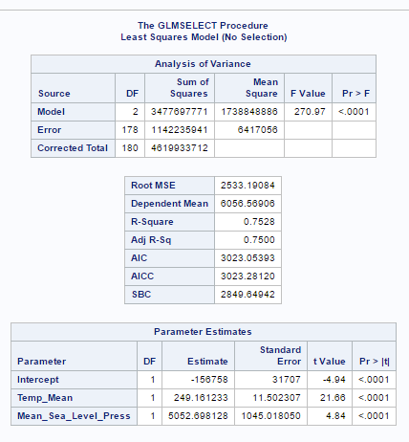
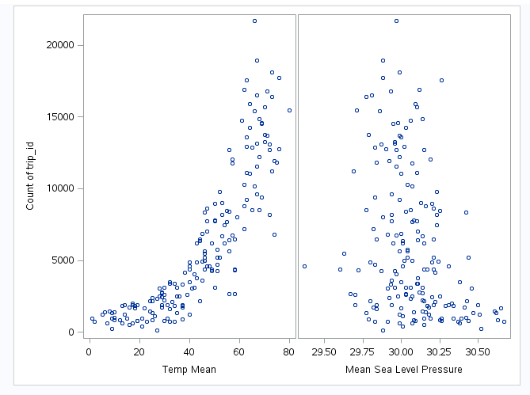
Regression Modeling Results Multilinear Regression
When Trip Count is modelled with Temperature and Sea Level Pressure through Multilinear Regression, we observe a significant relationship.
P value(<0.0001) rejects the null hypothesis.
F value is 270.97 which indicates that there is a strong relationship on the response variable by the predictor variable.
Adjusted R-Square value is 0.7500 which is closer to 1 which indicates that the variables fit better to the model.
From the above analysis, the Response variable can be determined by using the equation:-
Trip Count = -156768 + 249.161 * Temp_Mean + 5052.698 * Mean_Sea_Level_Pressure

Slide 15
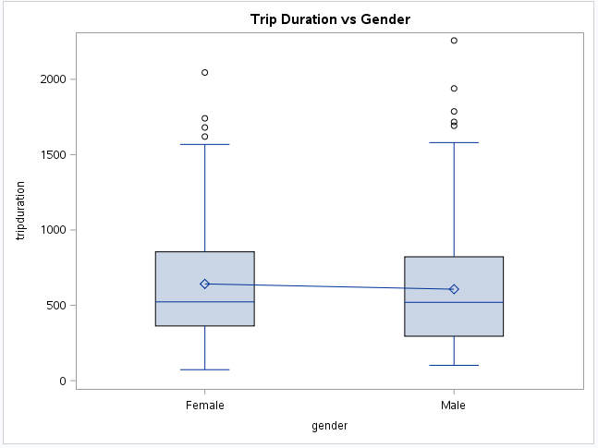
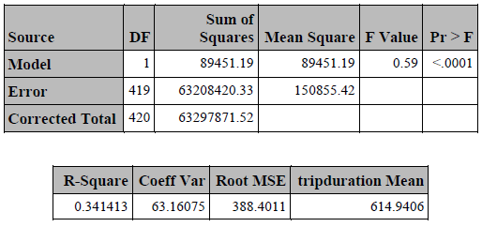
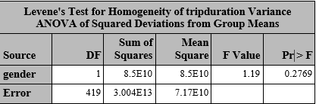
Trip Duration vs Gender using PROC GLM
Implementation of this model leads us to the inference that Female bike riders have longer trip durations than the male bike riders.
Graph.9 – Trip Duration vs Gender

Slide 16
Conclusion
The highest Trip Count was recorded during warmer months of the year and showed a gradual decrease in the cold months.
Trip Count has a strong positive linear relationship with Temperature and weak relationship with Humidity and Dew point.
Trip Duration also has a strong positive linear relationship with Temperature and weak relationship with Humidity and Dew-Point.
Hence Temperature has a more significant influence than Dew-Point and Humidity on Trip Count and Duration proving that temperature serves as the defining factor that can increase or decrease DIVVY ridership.
The multilinear regression model with temperature and Sea-level pressure as predictors against Trip count has a Adjusted R-Squared value of 0.7500.
Female bike riders have longer trip durations than the male population.

